Slide 1

Numerical Methods: A Fundamental Approach
Numerical methods are a crucial set of techniques used to solve complex mathematical problems that cannot be solved analytically. These methods involve converting continuous problems into discrete approximations that can be efficiently computed on digital computers.

Slide 2
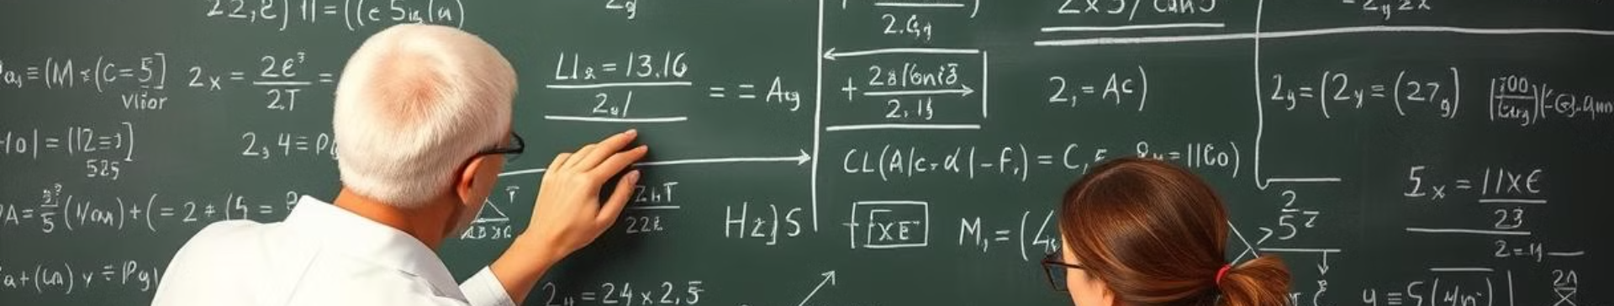
What are Numerical Methods?
1
Problem-Solving Approach
2
Computational Algorithms
3
Approximate Solutions
These methods translate mathematical problems into step-by-step computational procedures that can be implemented on digital computers.
Numerical methods produce approximate solutions that converge towards the true solution as the computational effort is increased.
Numerical methods provide a systematic way to solve mathematical problems that cannot be solved exactly using analytical techniques.

Slide 3
The Need for Numerical Methods
Analytical Limitations
Computational Power
Practical Applications
Many real-world problems are too complex to be solved analytically, particularly those involving nonlinear equations, differential equations, or large-scale systems.
Advances in computing power have made it possible to apply numerical methods to solve increasingly complex problems in science, engineering, and finance.
Numerical methods are essential for applications such as weather forecasting, fluid dynamics, structural analysis, and optimization problems.

Slide 4
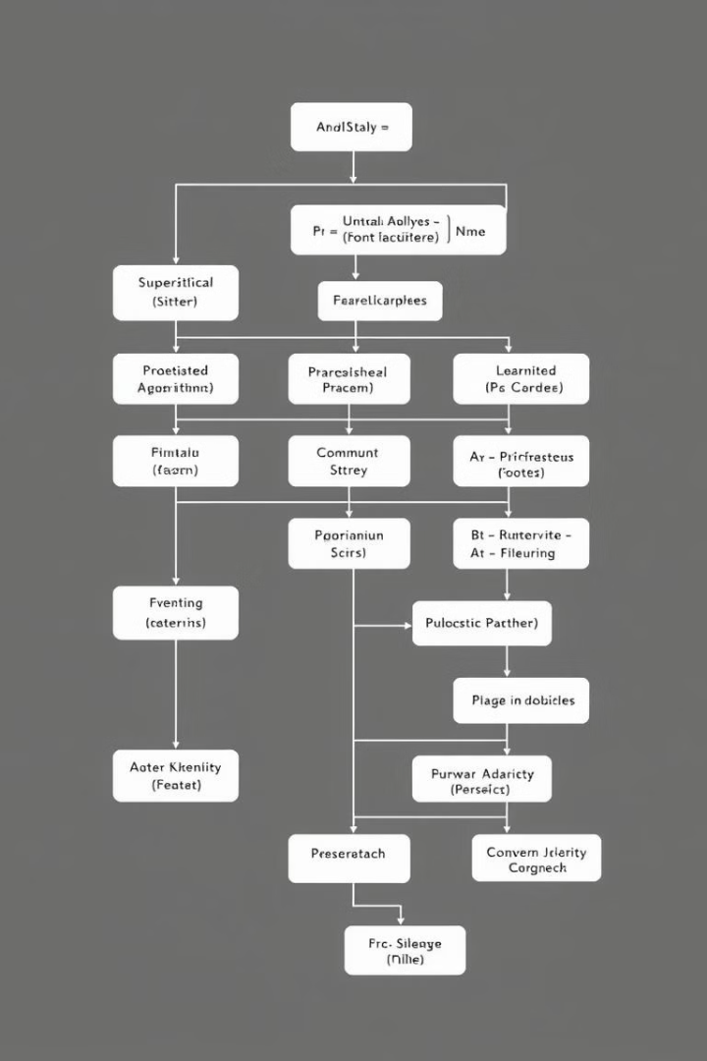
Common Numerical Techniques
Root-Finding Methods
Interpolation and Approximation
Techniques like the bisection method, Newton's method, and the secant method for finding the roots of nonlinear equations.
Methods for constructing approximate functions that fit a set of data points, such as polynomial interpolation and spline fitting.
Numerical Integration
Numerical Differentiation
Techniques like the trapezoidal rule and Simpson's rule for numerically evaluating definite integrals.
Methods for approximating the derivative of a function, such as finite difference approximations.

Slide 5
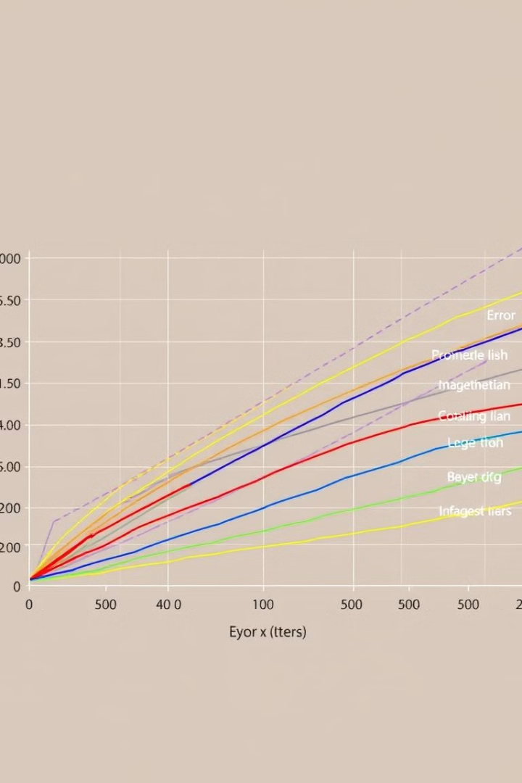



Error Analysis and Convergence
Discretization Error
Error introduced by approximating a continuous problem with a discrete computational model.
Roundoff Error
Error caused by the finite precision of computer arithmetic and the limited number of bits used to represent numbers.
Convergence Analysis
Determining the rate at which a numerical method's solution approaches the true solution as the computational effort is increased.

Slide 6
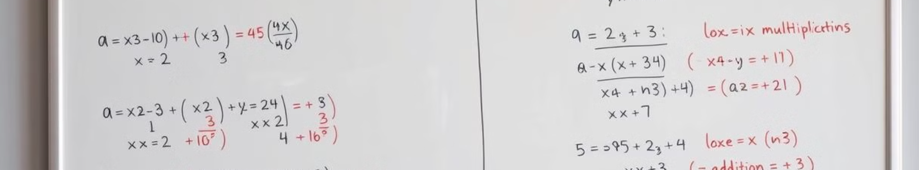
Solving Linear Systems
Direct Methods
Eliminate variables to find the exact solution, such as Gaussian elimination and LU decomposition.
Iterative Methods
Generate a sequence of approximate solutions that converge to the exact solution, such as Jacobi and Gauss-Seidel methods.
Sparse Matrices
Specialized techniques for efficiently storing and solving linear systems with sparse coefficient matrices.

Slide 7
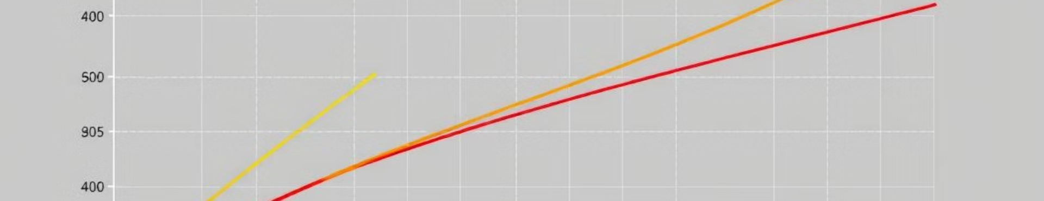



Interpolation and Approximation
Polynomial Interpolation
Spline Interpolation
Least Squares Approximation
Fitting a polynomial function to a set of data points to approximate the underlying function.
Fitting piecewise polynomial functions (splines) to a set of data points for a smoother approximation.
Fitting a function to a set of data points by minimizing the sum of the squared residuals.

Slide 8

Numerical Integration and Differentiation
Numerical Integration
Error Analysis
Approximating the value of a definite integral using techniques like the trapezoidal rule and Simpson's rule.
Studying the convergence and accuracy of numerical integration and differentiation methods, including truncation and roundoff errors.
1
2
3
Numerical Differentiation
Approximating the derivative of a function using finite difference methods, such as the forward, backward, and central difference formulas.

